Slide 1
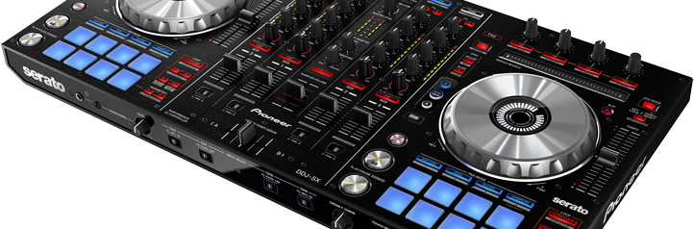
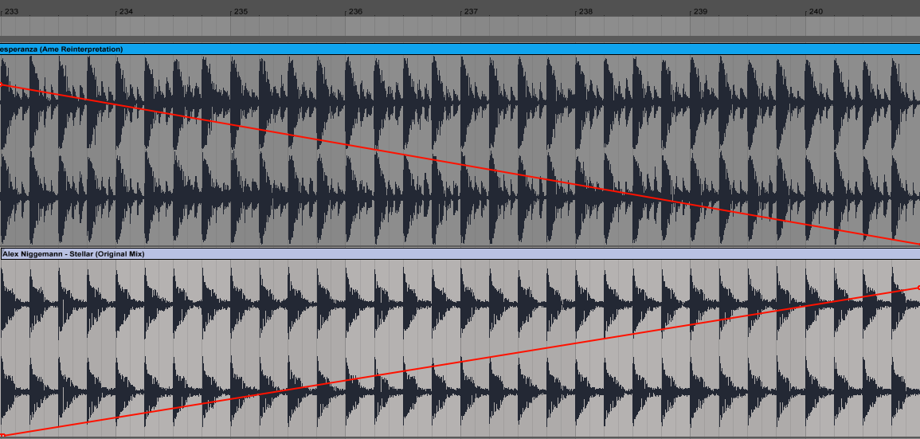
Automatic DJ Software
Devon D’Apuzzo | Victor Lalo | Matthew Shipley
Goal
Manual Algorithm Implementation
Results
Automatically mix an imported batch of songs together so that each song seamlessly transitions into the next.
Purpose
Allow user to playback a group of songs without breaks
Arrange songs together in a natural order
Seamlessly change tempo from song to song
Match up strong beats of each song during the transitions
Match up song entrances at strong phrase markers
Avoid clashes in frequency during the song transitions
Incorporate algorithm into an easy to use web-based interface
Strong beats in each song are detected. Tempos of both songs are shifted to the average BPM. The sample numbers of each strong beat are lined up over an identical 32-bar phrase. Linear fades are applied to ensure even output amplitude.
Include results based on your experiments
Result 2
Result 3
Current Alternatives
iTunes Crossfade: User sets a time length, and software fades out from the previous song and into the next song during the specified time
Spotify Gapless Playback: Zero gap between songs; immediately concatenates the two audio files, but no overlap between songs
VirtualDJ AutoMix: Closest to our desired outcome. User adds song to playlist, and VirtualDJ beatmatches the songs and continuously changes tempo during song transitions. VirtualDJ only mixes in the user selected order and does not automatically determine the optimal order
Human DJ: Dynamically selects and plays records, changing the speed and pitch manually and lining up phrases organically responding to the audience. Optimal sound, but requires a lot of equipment (turntables, mixer, amplifier).
Step 1
Describe this step in your experiment
Step 2
Describe this step in your experiment
Step 3
Describe this step in your experiment
Step 4
Describe this step in your experiment
Conclusion
Brief summary of what you discovered based on results
Indicate and explain whether or not the data supports your hypothesis
Works Cited
Include print and electronic sources in alphabetical order
Data / Observations

